Slide 1
WATERSHED
MANAGEMENT:
PROTECTING
METRO BACOLOD’S
WATER SUPPLY
Nathaniel von Einsiedel, PhD, FPIEP, FUAP President, ASSURE

Slide 2
Water Supply System of Metro Bacolod
2

Slide 3
WATER SUPPLY SYSTEM OF METRO BACOLOD
HISTORY
2019
BACIWA is in need of additional 40-60 million liters to meet the demand. Additional water supply from Murcia Water District was used to address shortage
In Negros Occidental, the different water districts and waterworks serve 123,988 connections.
Most if not all water districts derive their supply from deep wells.
Bacolod Water District supplies 75,000 cu.m. a day.
Shortage
at least
5,000 m3/day
Metro Bacolod
daily requirement
70,000 to
123,000 m3/day
Source: https://www.green.org/philippines
3

Slide 4
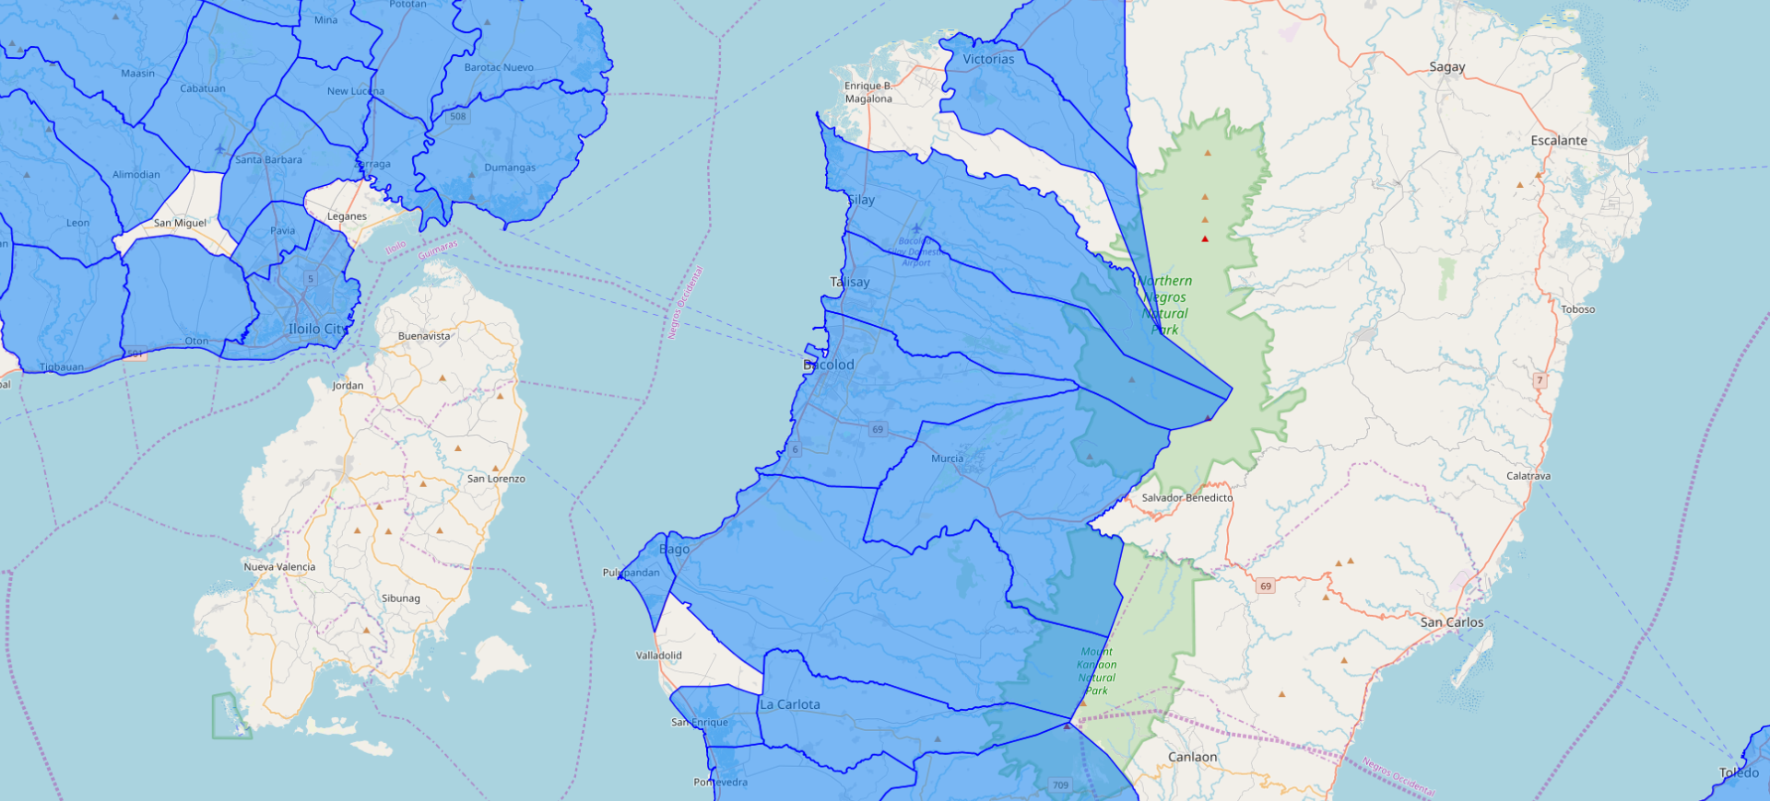
WATER SUPPLY SYSTEM OF METRO BACOLOD
Legend:
LWUA Water Districts
Source: http://www.geoportal.gov.ph/
4

Slide 5
WATER SUPPLY SYSTEM OF METRO BACOLOD
HOUSEHOLDS WITH ACCESS TO SAFE WATER SUPPLY
AND WITH SANITARY TOILET FACILITIES
HH with access to
safe H2O supply
88.15%
NEGROS OCCIDENTAL 2018
Number of Households | 575,190
HH with access to safe H20 supply | 507,045
HH with sanitary toilets | 436,356
HH with satisfactory disposal of solid waste | 427,508
HH with complete basic sanitation facilities | 370,183
HH with complete basic sanitation facilities
64.36%
HH with
sanitary toilets
75.86%
Source: NEDA Region VI Water and Sanitation Statistics
HH with satisfactory disposal of solid waste
74.32%
5

Slide 6
Urban Growth of
Metro Bacolod
6

Slide 7
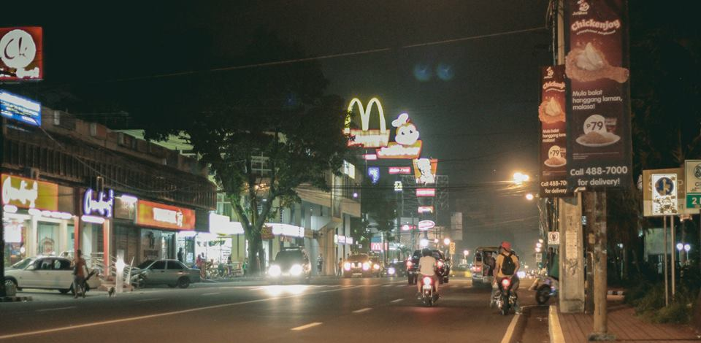
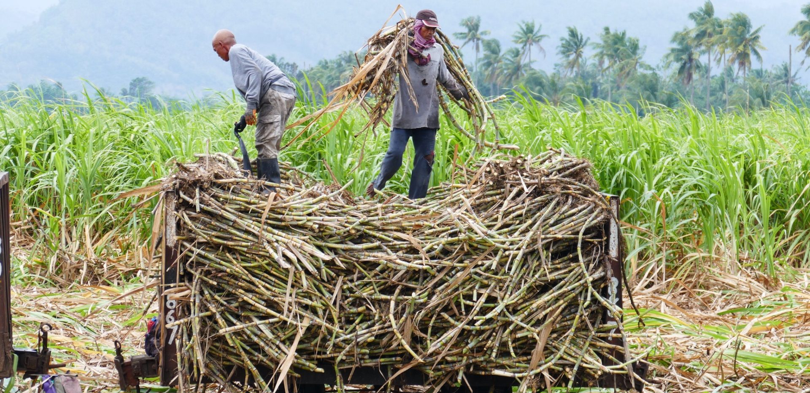
URBAN GROWTH OF METRO BACOLOD
Negros Occidental registered a total population of 3,059,136 and a growth rate of 1.03.
The Metro Bacolod area recorded 1,043,286 with a growth rate of 1.57.
Majority of Metro Bacolod is urban. Bacolod City has the largest percentage of urban area with 83.61%.
However some areas such as Talisay City, Silay City and Municipality of Murcia are still predominantly rural, with less than 30% listed as urban.
Lacson Street, Bacolod City
Sacada workers in Talisay City
Source: PSA Philippine Standard Geographic Code
7

Slide 8
URBAN GROWTH OF METRO BACOLOD
DRIVERS OF URBAN GROWTH IN METRO BACOLOD
BPO-Industry
OFW
Real Estate
Developments
Tourism
8

Slide 9
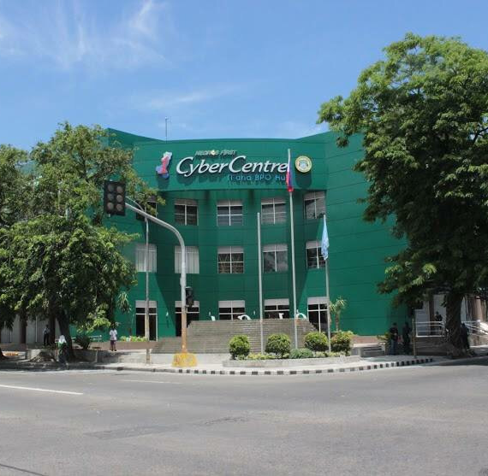
URBAN GROWTH OF METRO BACOLOD
Growth of BPO Industry
Negros Occidental and Bacolod City have been active in attracting outsourcing investments. The BPO and KPO industries are considered as a major job-generating sector.
The BPO-IT industry created 12,000 jobs in Bacolod and generated 35,000 jobs as of Feb. 2020, or an increase of 23,000 jobs.
Bacolod City is a Center of Excellence in Information Technology-Business Process Outsourcing (IT-BPO), joining Metro Manila, Metro Cebu and Metro Clark (May 2013)
Source: Colliers International Philippines
Negros First CyberCentre IT and BPO Hub in Bacolod City
9

Slide 10
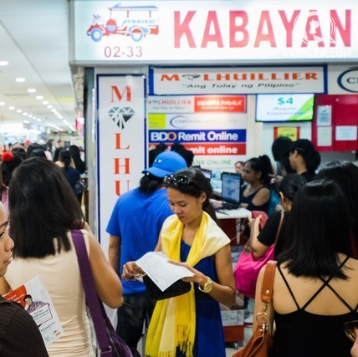
URBAN GROWTH OF METRO BACOLOD
OFWs – The New Middle Class
Negros Occidental is one of the top 3 leading provinces with the highest remittance and number of OFWs.
Real estate developers in Bacolod reveal that about 80%-90% of the buyers are OFWs.
The Negrense OFWs are one of the significant contributors to the economic development and activities in the province.
Source: Sugar and Smiles by Elias A. Gatanela Jr.
Source: rappler.com
10

Slide 11
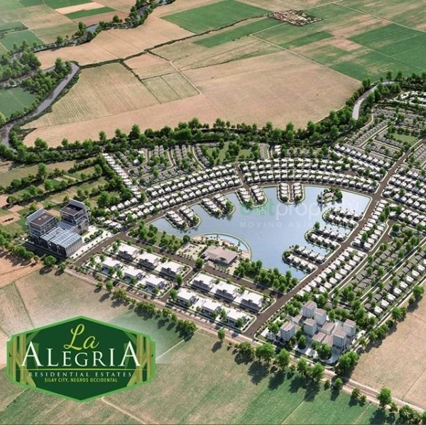
URBAN GROWTH OF METRO BACOLOD
The Real Estate Boom in Metro Bacolod
Bacolod was listed as the no. 1 of the “Best Places to Live in the Philippines” by Moneysense Magazine on April 1, 2008.
With its award in 2017 and in 2019 as the Most Livable Urban Center across the country after bagging the Philippine Model City 2019 award given by The Manila Times, Bacolod continues to attract big national real estate developers for property development.
Major real estate companies currently operating in Metro Bacolod include Sta. Lucia Realty, Ayala Land Inc., Vista Land, Megaworld, Filinvest Land, Rockwell Land, Robinsons Land Corp., SMDC, and Cebu Land Masters.
La Alegria Residential Estates, Silay City
Source: Sugar and Smiles by Elias A. Gatanela Jr.
11

Slide 12
URBAN GROWTH OF METRO BACOLOD
Tourism
Magikland, Silay City
Travel and tourism-related industry is a major driver of economic growth in Visayas.
In Western Visayas, the Philippine Tourism Master Plan identified Bacolod and Silay in Negros Occidental as one of the 4 Tourism Development Areas.
Tourist arrivals of Negros Occidental for 2017 totalled to 3,577,514 persons (Foreign, Domestic, OFWs and Excursionists).
Source: Visayan Spatial Development Framework 2015-2045
12

Slide 13
Watershed Management
13

Slide 14
WATERSHED MANAGEMENT
ISSUES AND CONCERNS
Increasing and expanding settlements and farms
Deforestation
Tourism
Absence of land use and watershed management plans
Absence of watershed resources valuation system
Inadequate support of existing political and institutional support to watershed management
Climate change
14

Slide 15
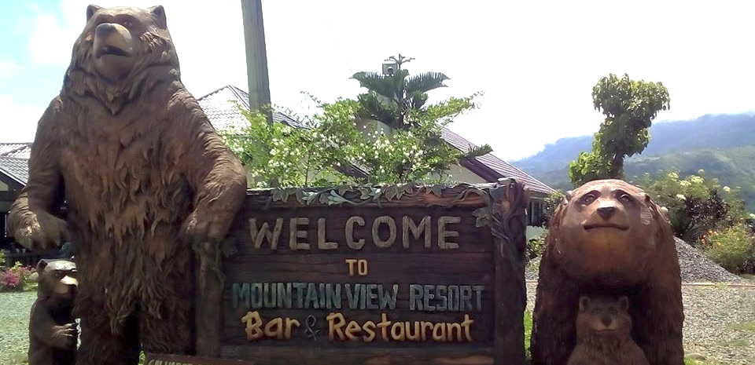
WATERSHED MANAGEMENT
NEGATIVE EFFECTS OF DEVELOPMENTS IN WATERSHED AREAS
Data obtained from the Provincial Environment and Natural Resources (PENRO) says there are at least 200 illegal structures at the Northern Negros Natural Park (October 2019).
Aside from the NNNP, there are also illegal structures at the Mt. Kanlaon Natural Park (MKNP).
Rooster Cafe, Silay City
Mountain View Resort in Don Salvador Benedicto
Source: https://www.sunstar.com.ph/article/1826764
15

Slide 16
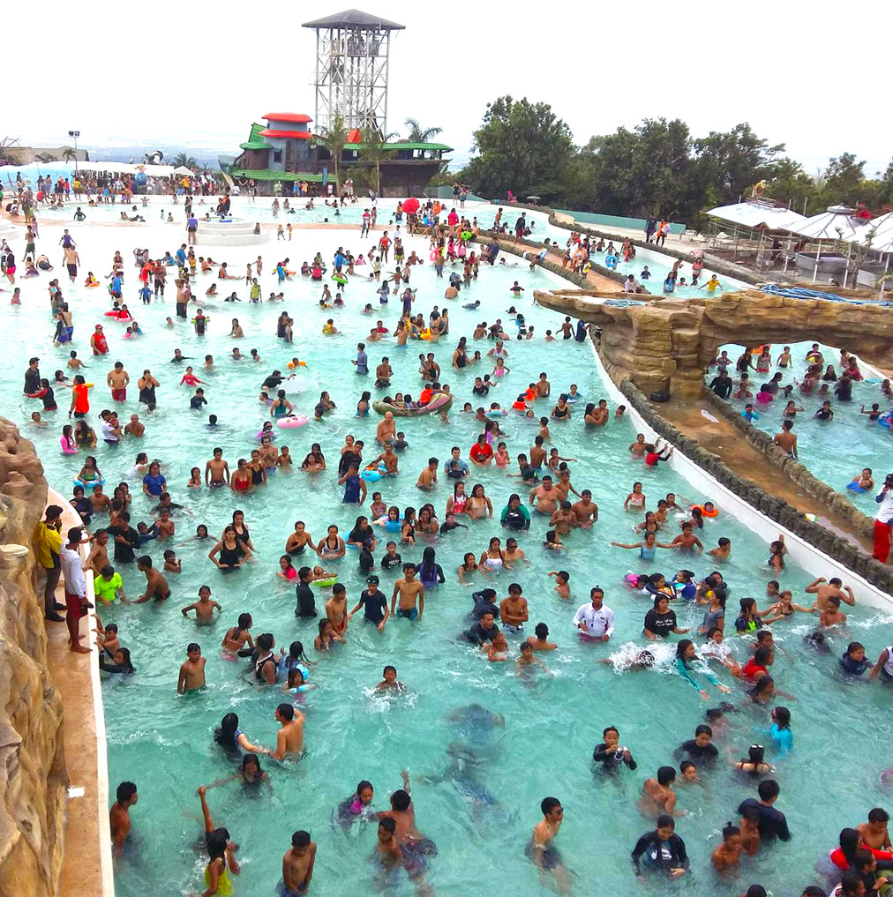
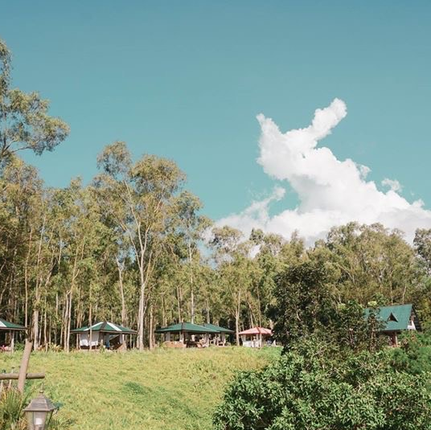
WATERSHED MANAGEMENT
NEGATIVE EFFECTS OF DEVELOPMENTS IN WATERSHED AREAS
Campuestohan Highland Resort, Talisay City
Lantawan View Resort, Silay City
16

Slide 17
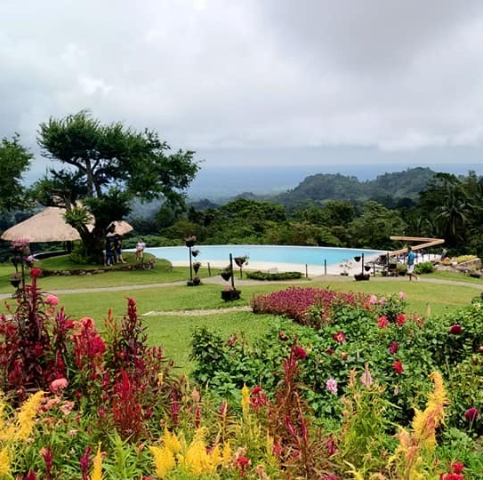
WATERSHED MANAGEMENT
NEGATIVE EFFECTS OF DEVELOPMENTS IN WATERSHED AREAS
Ilaya Highlands, Patag, Silay City
Duyan Cafe, Silay City
17

Slide 18
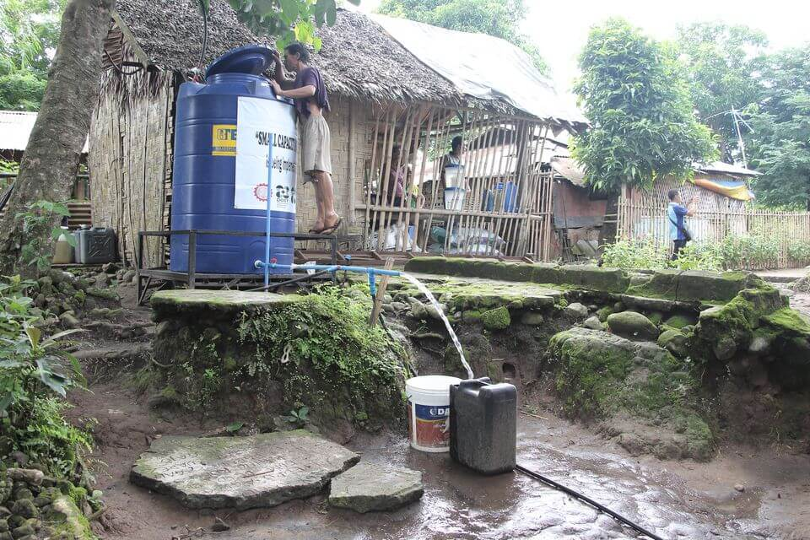
WATERSHED MANAGEMENT
The Upper Caliban River located at Mt. Managaksak along Mount Mandalagan Mountain Range has been the supply source of the BACIWA.
There are three major watershed forest reserves in the province, namely:
Bago River Watershed
Ilog-Hilabangan Watershed
Kabankalan Watershed
Installation of solar-powered water system in the community of Sitio Mirasol, Caliban
18

Slide 19
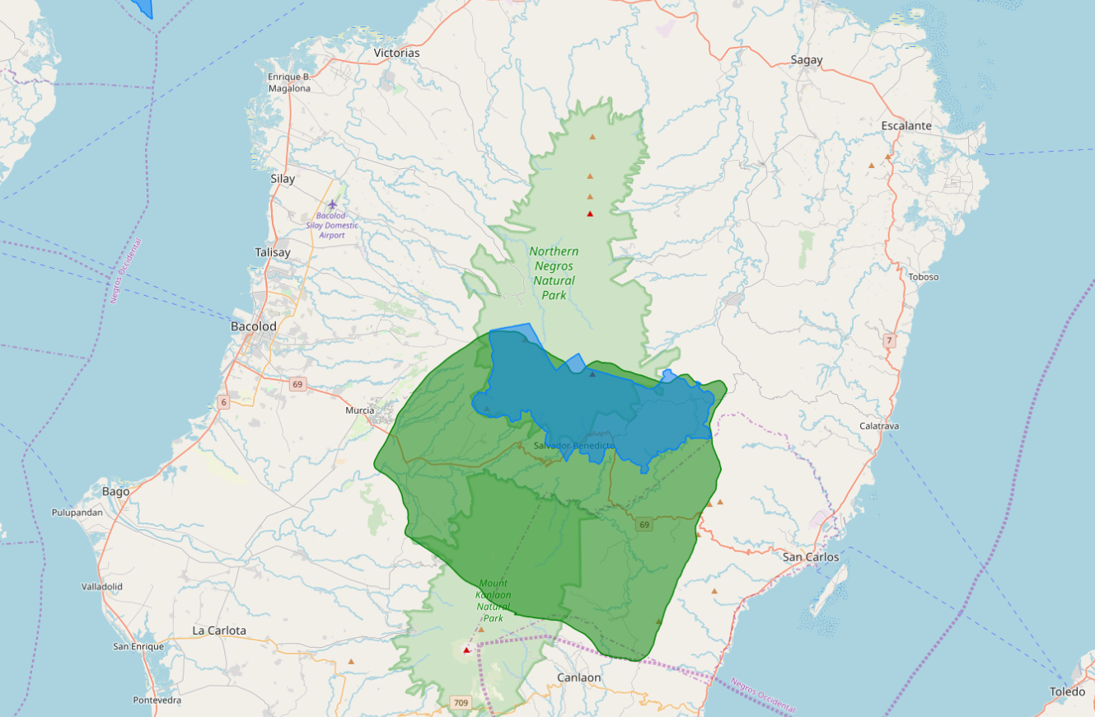
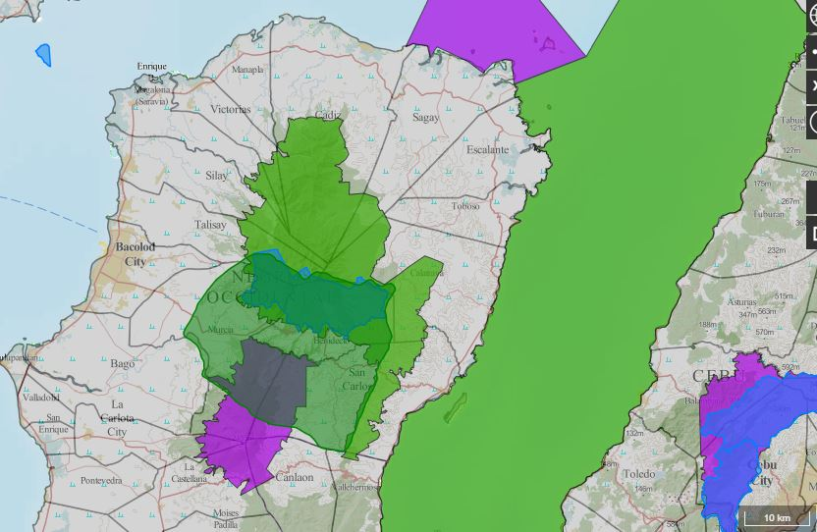
WATERSHED MANAGEMENT
WHAT IS A WATERSHED?
Any topographically delineated area that can collect water and is drained by a river system with an outlet
Legend:
Proclaimed Watershed
Critical Watershed
Source: http://www.geoportal.gov.ph/
19

Slide 20
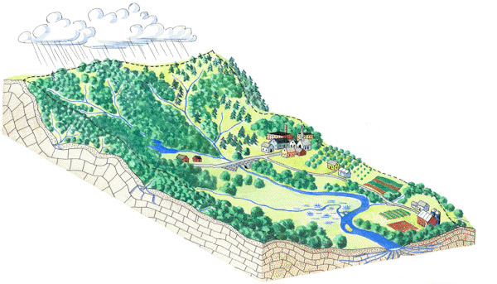
WATERSHED MANAGEMENT
The process of guiding and organizing the use of land and other resources in a watershed to provide goods and services without adversely affecting soil and water resources.
The application of business methods and technical principles to the development and control of watershed resources to achieve a desired set of objectives such as maximum supply of usable water, prevention of soil erosion and siltation, and mitigation of climate change impacts (e.g. flooding, extreme heat, drought)
Secondary Forest
Primary Forest
Urban
Agro-
forestry
Agriculture
Grasslands
Watersheds
20

Slide 21
WATERSHED MANAGEMENT
WHAT ARE THE BASIC OBJECTIVES OF WATERSHED MANAGEMENT?
Bago River
To protect, conserve and improve the land of a watershed for more efficient and sustained production.
To manage and utilize the runoff water for useful purposes.
To check soil erosion and reduce the effect of sediments on the watershed.
To moderate infiltration of rainwater.
To improve and increase biodiversity, and wildlife resources.
To enhance the groundwater recharge.
To minimize the risks of floods and landslides.
21

Slide 22
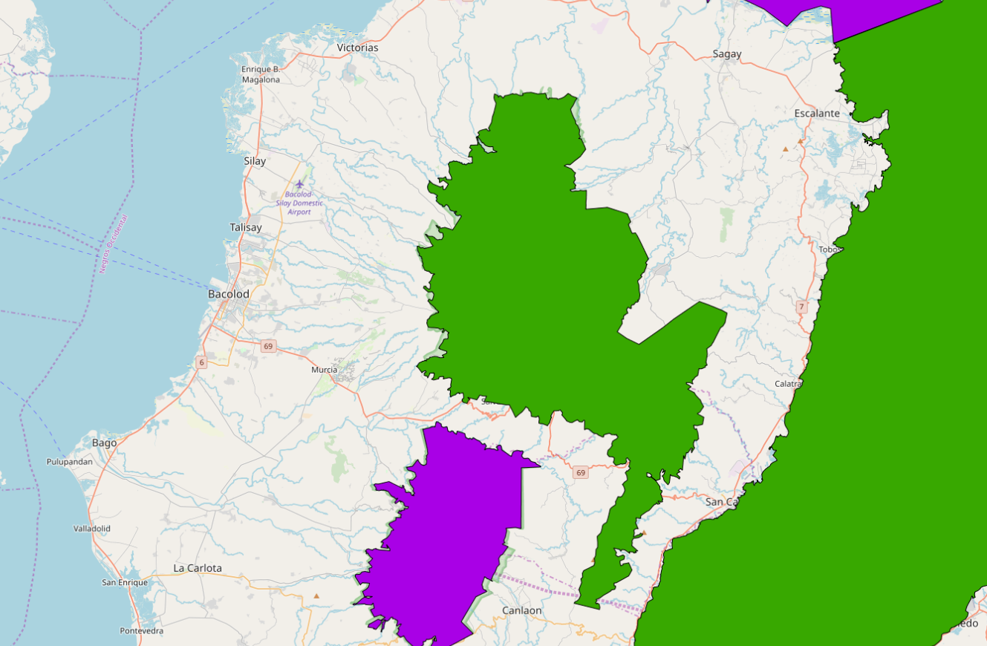
WATERSHED MANAGEMENT
PROTECTED AREAS
Protected areas in the province of Negros Occidental are classified as Natural Parks, National Marine Reserves and Watershed Forest Reserves.
Other protected areas under Natural Parks are Mt. Kanlaon, North Negros Forest Reserve and Sagay City Marine Reserve.
Legend:
Legislated ENIPAS
Legislated NIPAS
Source: http://www.geoportal.gov.ph/
22

Slide 23
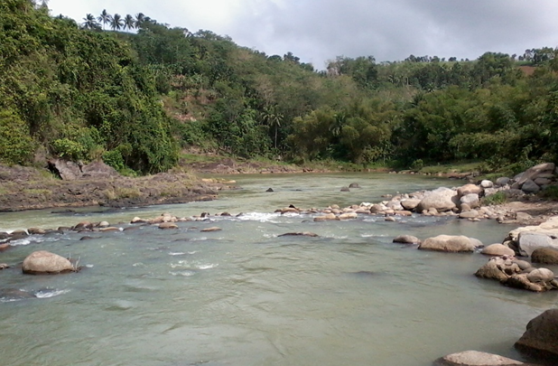
WATERSHED MANAGEMENT
WHY IS A WATERSHED IMPORTANT?
Aside from land and water, it contains many valuable resources such as plants, animals, minerals and ecosystems that support human life.
It is a major site for various land uses, many of which are in conflict and in competition with each other for land.
It is a major source of nutrients as well as pollutants, which are deposited in lakes, rivers and coastal areas.
Northern Negros Natural Park
23

Slide 24
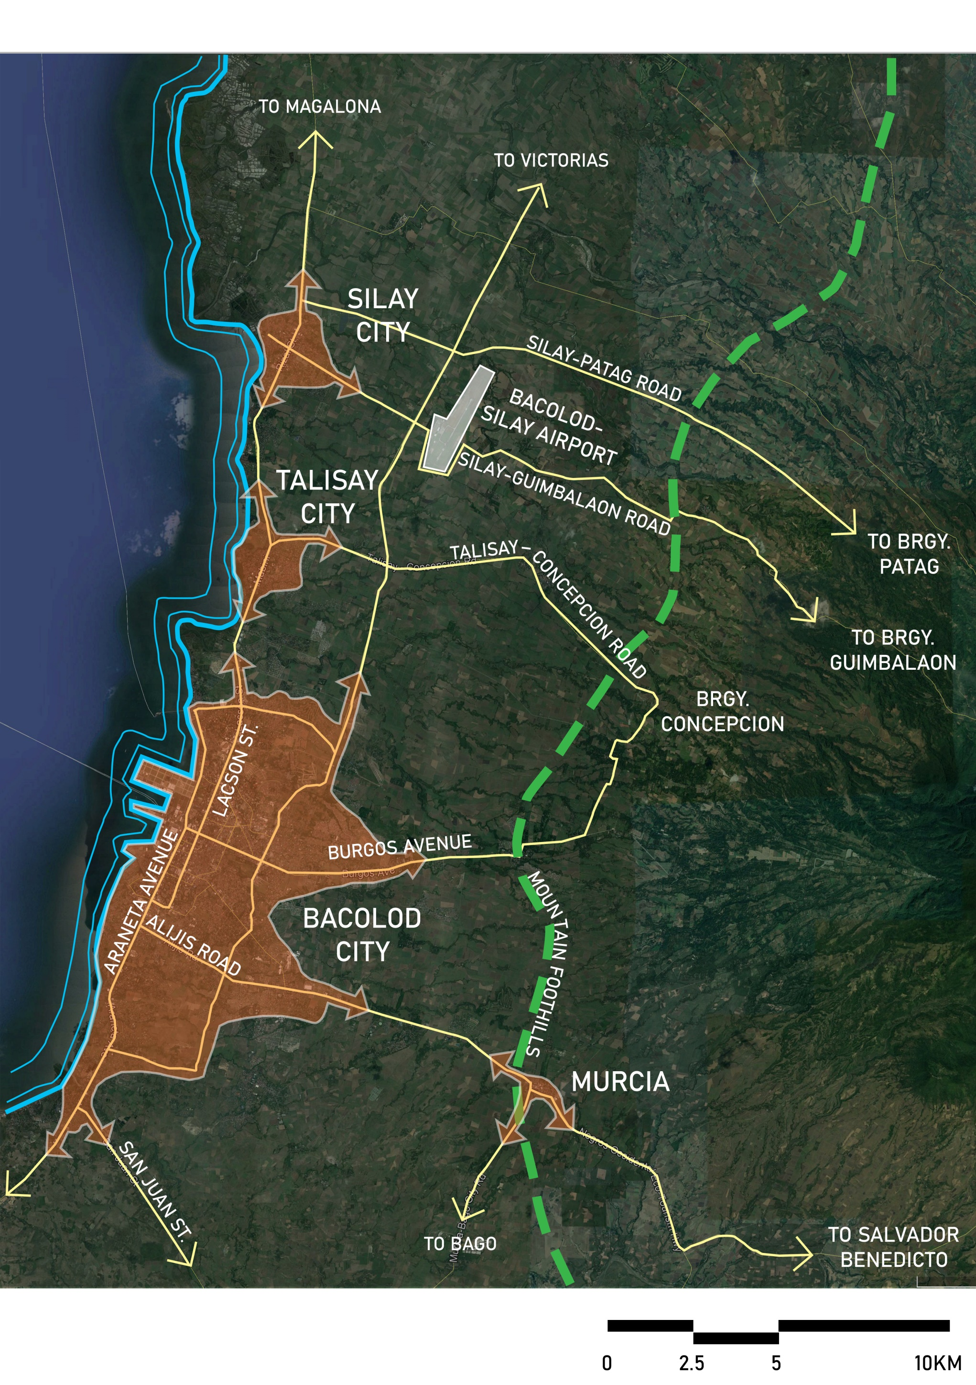
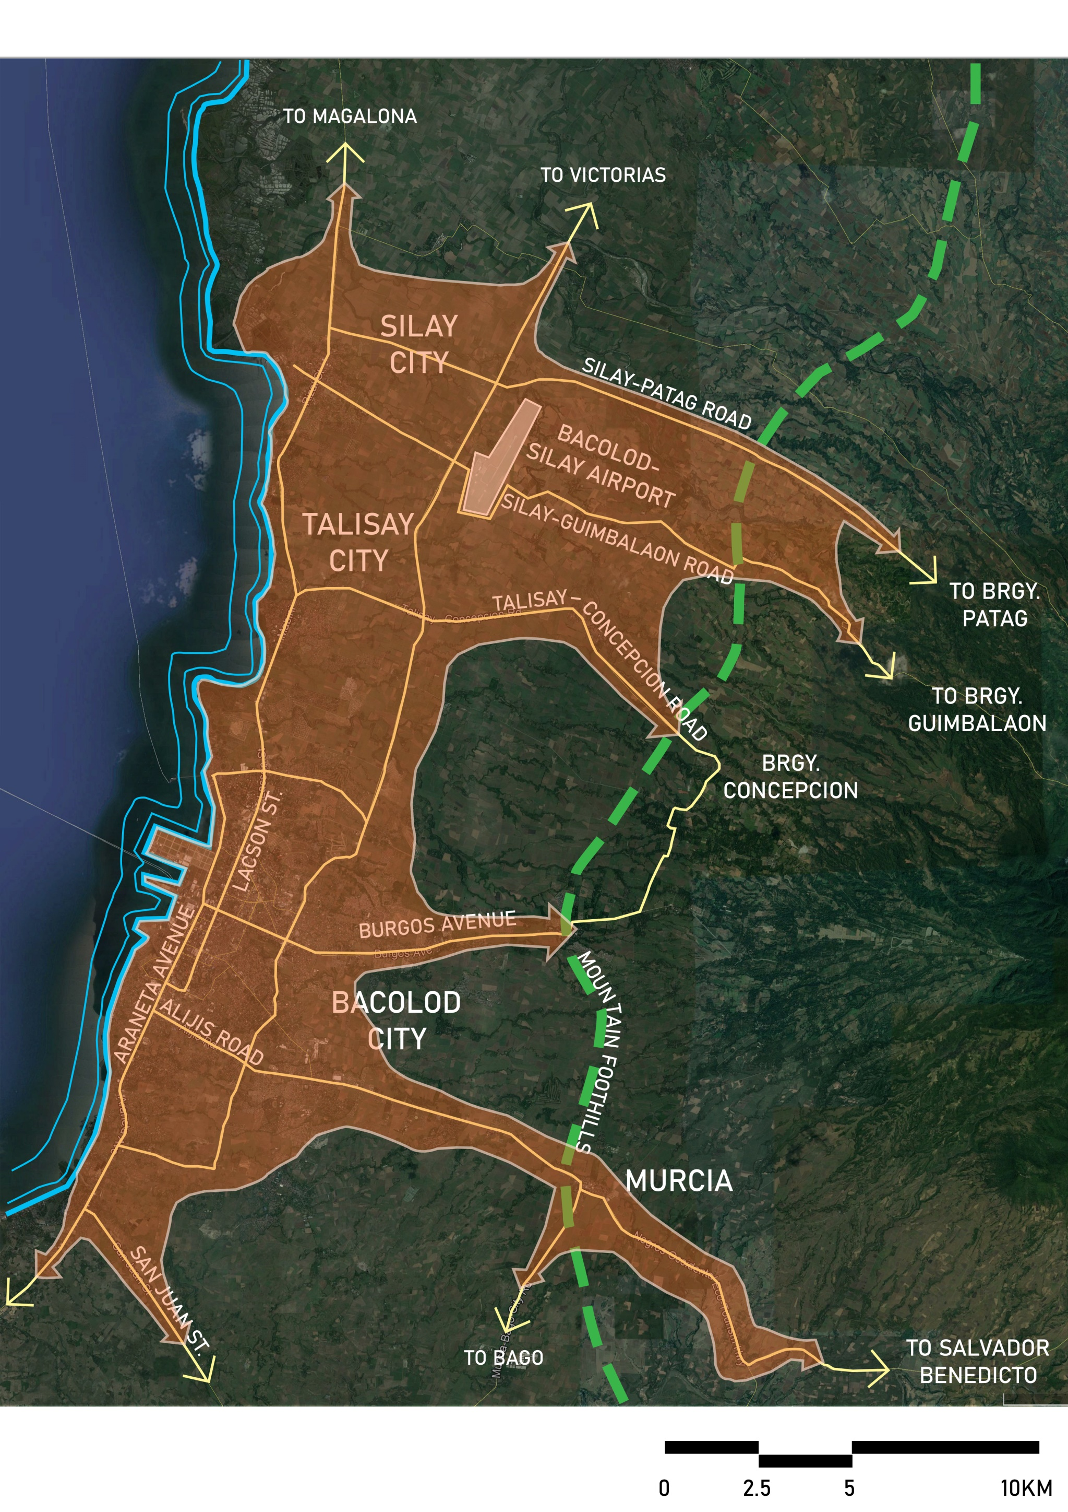
WATERSHED MANAGEMENT
EXISTING
BUILT-UP AREA
FUTURE BUILT-UP AREA
(URBAN SPRAWL)
24

Slide 25
The destruction of watersheds is similar to the frog in a vat with boiling water.
The frog doesn’t realize it will die until it’s too late.
25

Slide 26
Thank you.
Nathaniel von Einsiedel
nveinsiedel@gmail.com
www.concepinc.com

